Slide 1
Advanced Systems Analysis and Design Transition to the new system SOFT 30121 L18

Slide 2

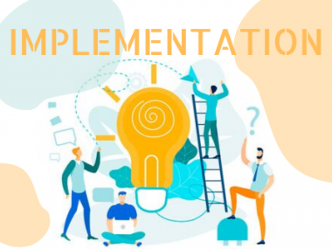
Transition to the new system
RecoSystems Analysis and Design
Alan Dennis; Barbara Haley Wixom; Roberta M. Roth
2019
Chapter 13

Slide 3
Transition to the new system
Objectives of Lecture 18
Explain the system installation process.
Describe the elements of a migration plan.
Explain different types of conversion strategies and when to use them.
Describe several techniques for managing change.
Outline postinstallation processes.
SOURCE: RecoSystems Analysis and Design
Alan Dennis; Barbara Haley Wixom; Roberta M. Roth
2019
Chapter 13

Slide 4
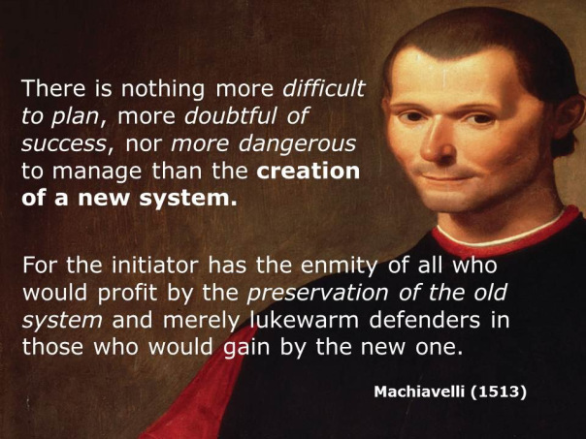
Past Wisdom
This Photo by Unknown Author is licensed under CC BY-SA-NC

Slide 5
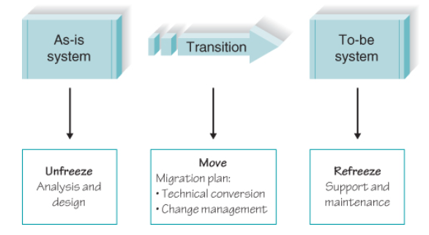
Kurt Lewin’s Model for Managing Organizational Change

Slide 6
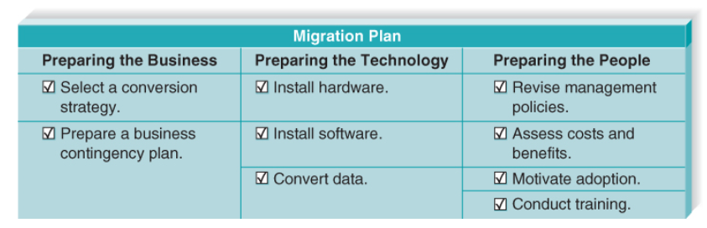
The Migration Plan

Slide 7
Migration Plan
Preparing a Business Contingency Plan
Contingency plans help the business withstand relatively small problems with the new system so that major business disruptions are prevented.
Preparing the Technology
Sometimes the project requires new servers, client computers, printers, and networking equipment. The new hardware requirements should have been defined in the hardware and software specifications during design
Preparing People for the New System
In the context of a systems development project, people who will use the new system need help to adopt and adapt to the new system. The process of helping them adjust to the new system and its new work processes without undue stress is called change management.

Slide 8
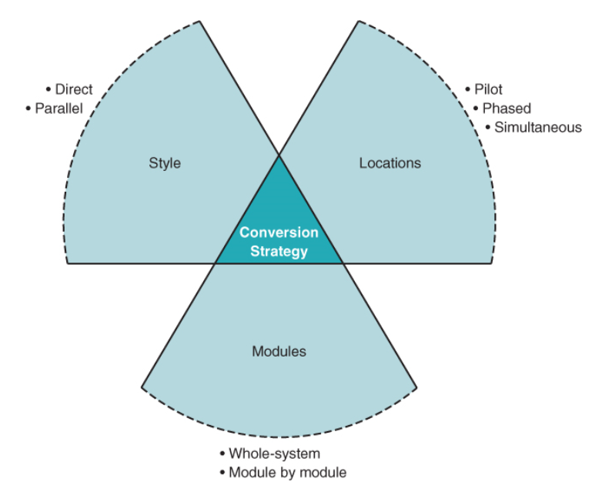
Selecting a Conversion Strategy

Slide 9
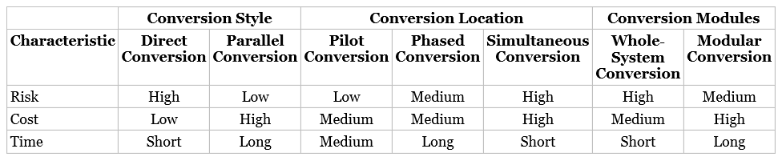
Evaluating Strategy Choices

Slide 10
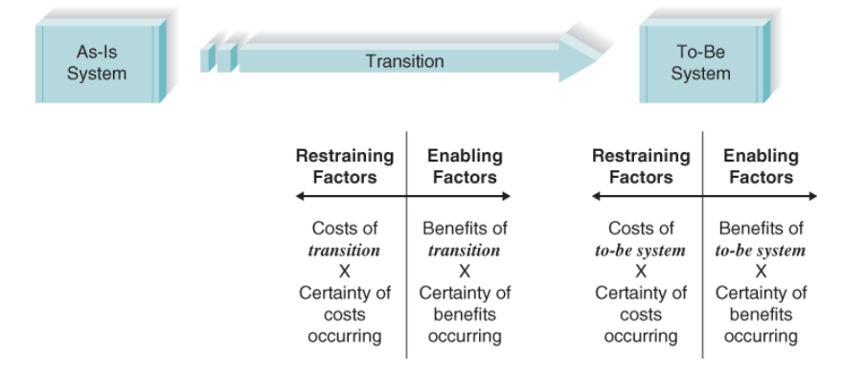
Resistance to Change

Slide 11
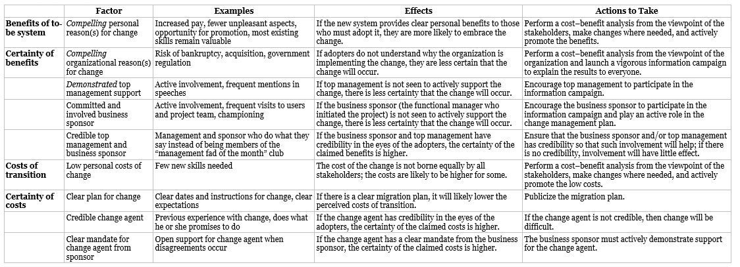
Costs and Benefits

Slide 12
Costs and Benefits

Slide 13
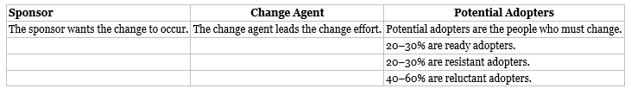
People and Political Challenges

Slide 14
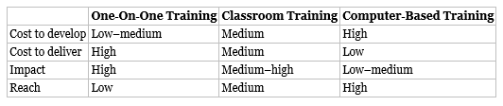
Developing your Training Plan

Slide 15
Postimplementation Activities
System Support
System Maintenance
Implementation Review

Slide 16
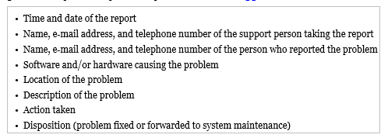
System Support
Most organizations provide a help desk that provides a place for a user to talk with a person who can answer questions (usually over the phone, but sometimes in person). The help desk supports all systems, not just one specific system, so it receives calls about a wide variety of software and hardware.

Slide 17
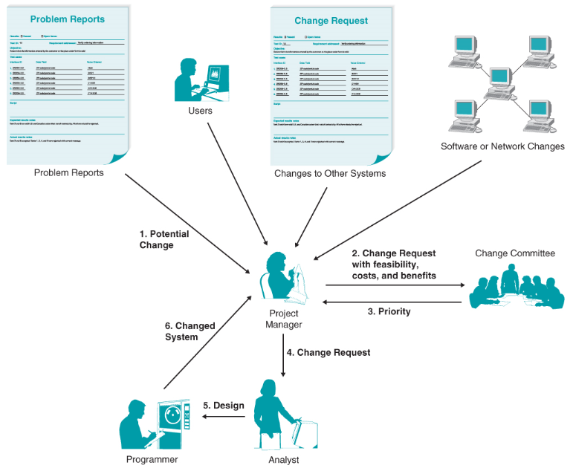
System Maintenance

Slide 18
Implementation Review
The goal of project assessment is to understand what was successful about the system and the project activities (and therefore should be continued in the next system or project) and what needs to be improved. Project assessment is not routine in most organizations, except for military organizations, which are accustomed to preparing after‐action reports.

Slide 19
Lecture 18 review
Objectives of Lecture 18
Explain the system installation process.
Describe the elements of a migration plan.
Explain different types of conversion strategies and when to use them.
Describe several techniques for managing change.
Outline postinstallation processes.

Slide 20
Next Lecture
Constructing Your Sprint Plan

